Slide 1
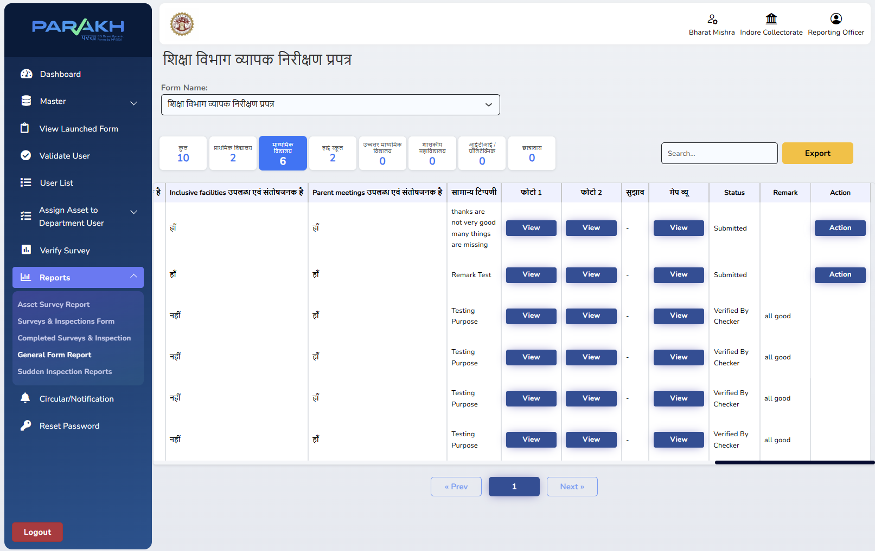
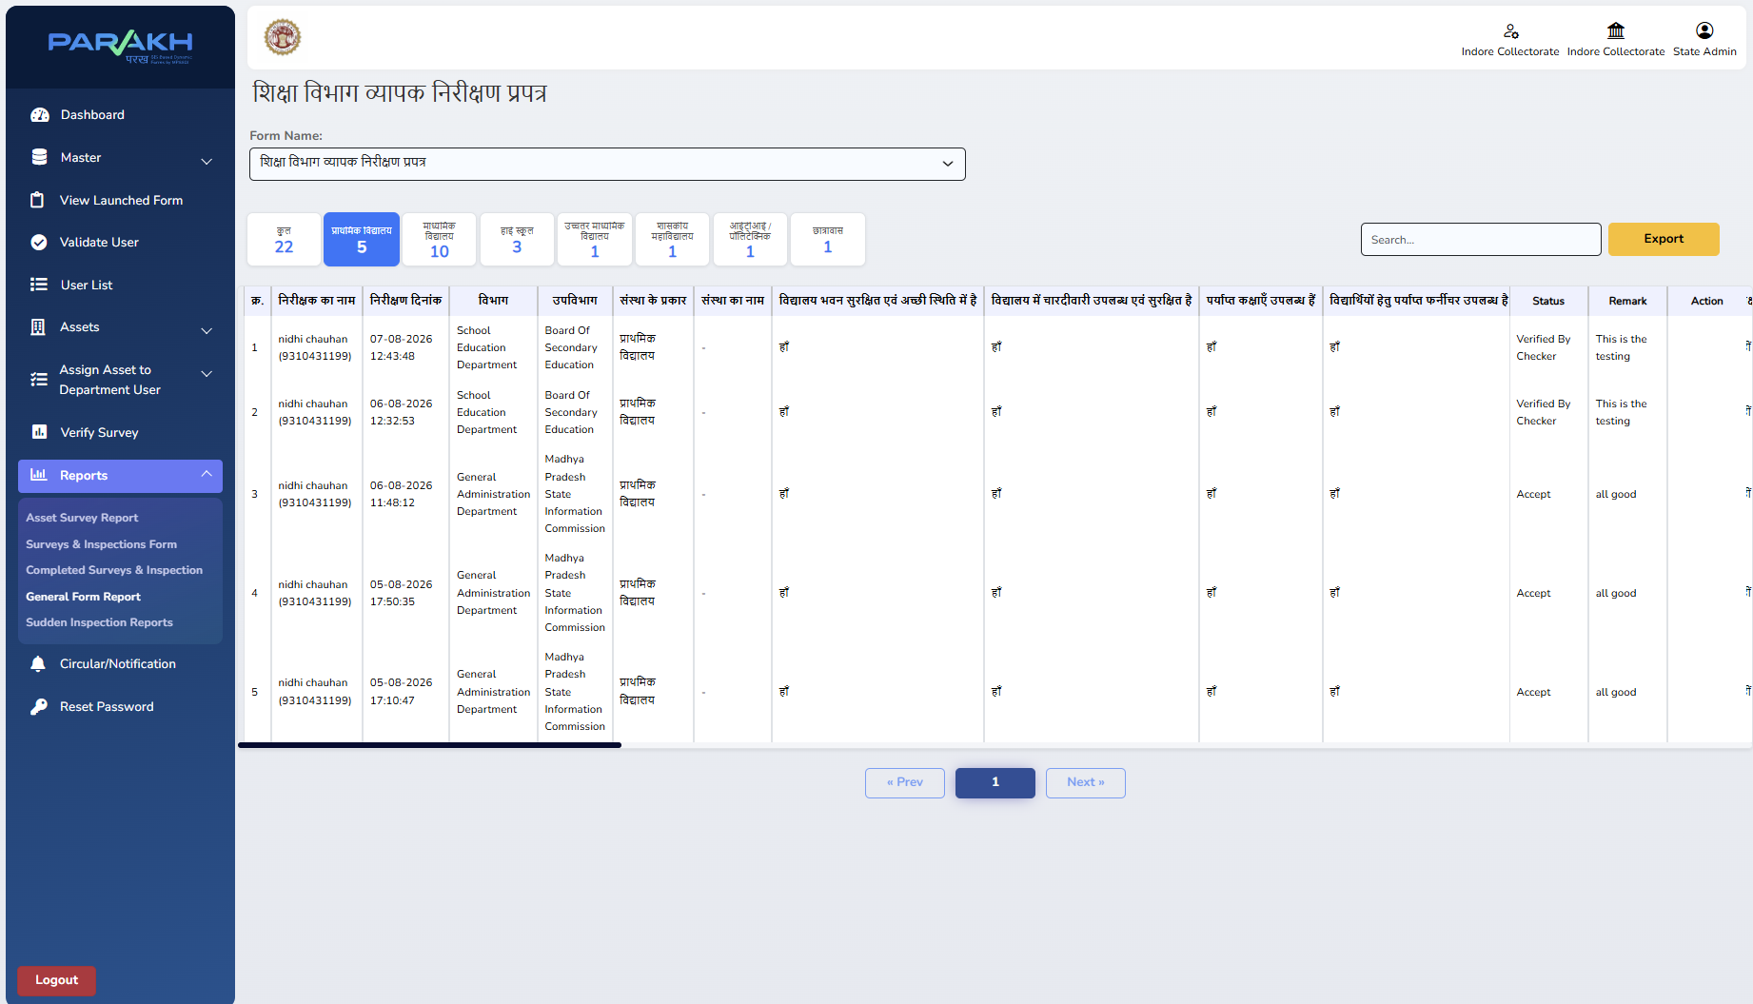
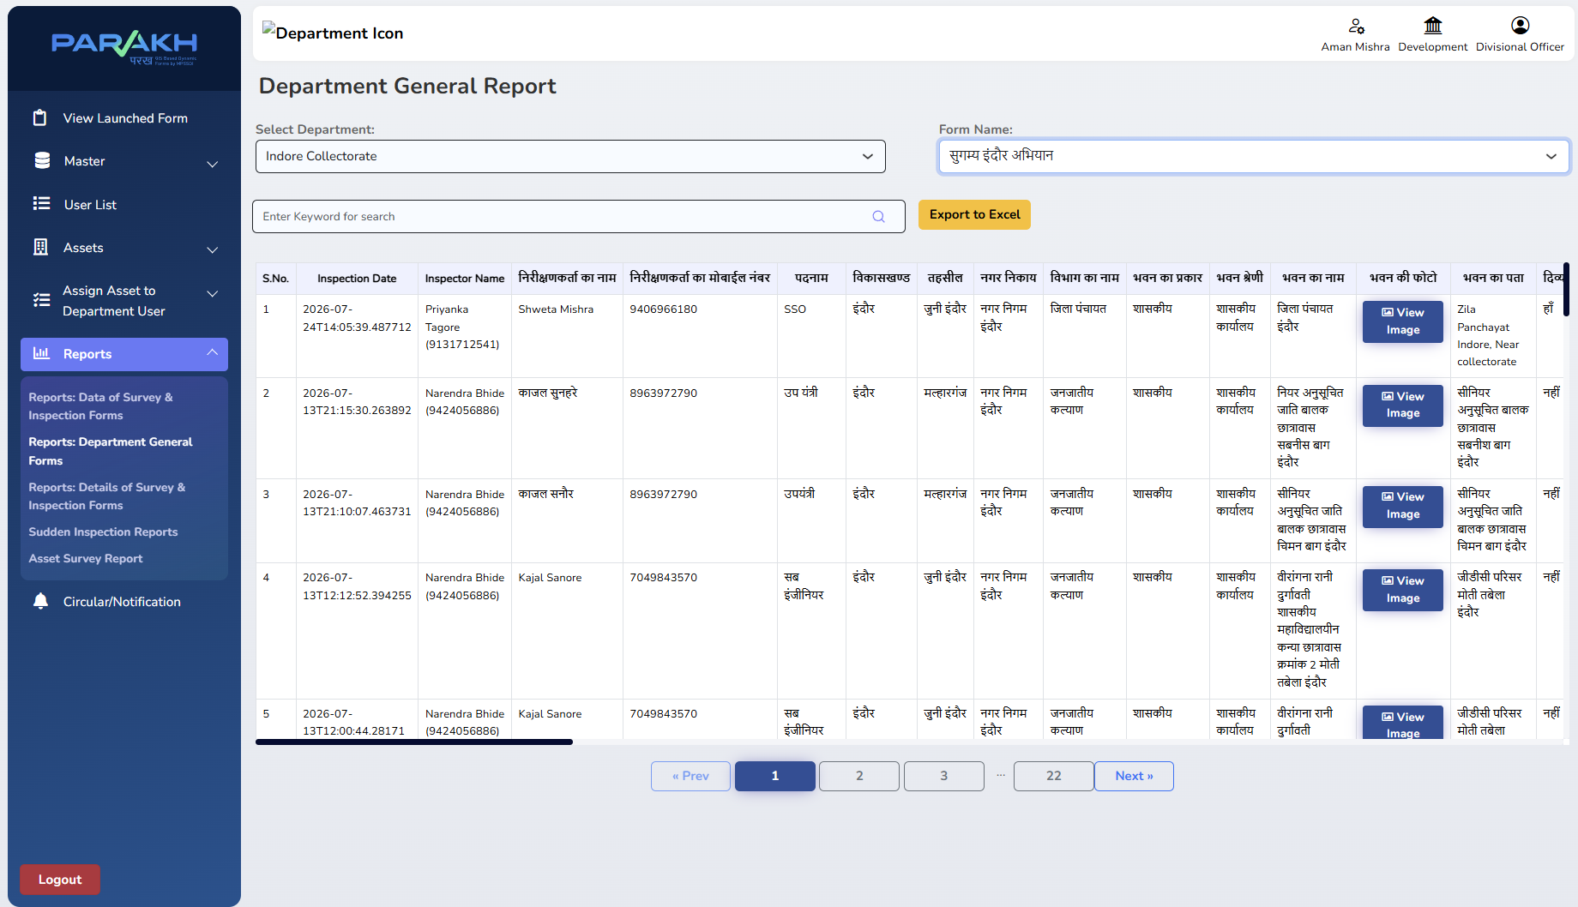
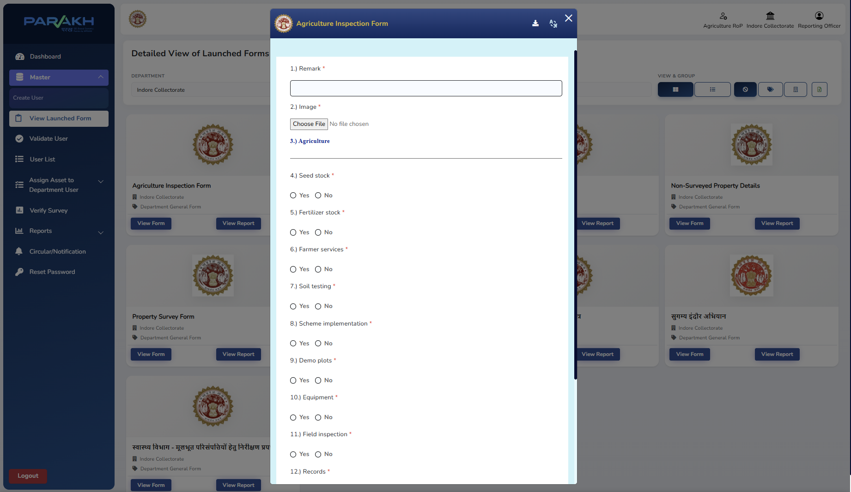
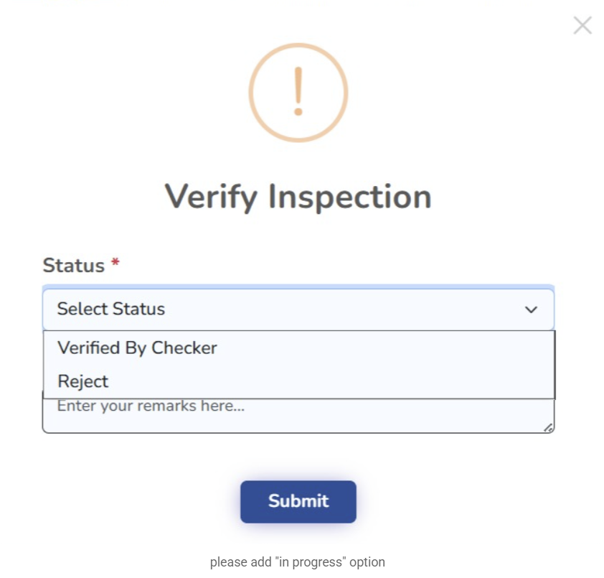
Division-Level Inspection Monitoring — District GIS Parakh (MPSeDC)
Use Cases- District GIS Parakh enables centralized inspection monitoring across all 8 districts of Indore Division through a unified divisional hierarchy. It provides district- and department-wise visibility, division-scoped user management, and consolidated inspection reports for effective review and administrative monitoring.
End-to-End Inspection Workflow: Field Capture → Review & Action → Collectorate Monitoring → Divisional Monitoring
1 FIELD INSPECTION
Mapped RO reviews
3 COLLECTORATE MONITORING
4 DIVISIONAL MONITORING
Department-specific checklist
Remarks • Photos/Documents
Reporting Officer reviews
Verifies / Rejects with remarks
State Admin / Nodal Officer
Consolidated district-level oversight
8 districts + departments
Division-level report & analytics
INSPECTION FORM
Verify Inspection: only by mapped RO
COLLECTORATE
DIVISIONAL MONITORING
Published department inspection form / checklist
Verify Inspection: status + remarks
State Admin view: Verified / Accept status
Division-level Department General Report
Form / Checklist
RO Action
District Monitoring
Division Monitoring
ONE PLATFORM • MULTIPLE DEPARTMENTS • 8 DISTRICTS • NEW: ACTION MENU (VERIFY & REJECT) + BILINGUAL FORM SEARCH

Slide 2
Meeting Highlights — Indore Division Forms Dashboard
Translated summary of the Indore Division Forms MoM • 17-Sep-2026
Executive Summary
17 new forms approved for all 8 districts
Per the Commissioner's direction, Action Taken and departmental forms will no longer be limited to Indore Collectorate alone, but made available across all 8 districts of the Division (Jhabua, Khandwa, etc.).
New Action menu + bilingual search in the mobile app
A separate Action menu will be added for Verify and Reject, and forms can now be searched in both Hindi and English.
Dashboard & form-launch timeline
The first version of the Project Parakh dashboard goes live today; the remaining forms (of the 17) will be completed within the following week.
Data access & security confirmed
Data is visible only within the relevant department ('Belongs to Department') and its governing authority — e.g. Indore's Mining Officer cannot view Dhar's data.
Key next steps
The user manual/documentation is to be updated, while reporting and the new Action menu are targeted to go live by Monday.
Source: Indore Division Forms MoM Meeting Transcript — translated Hindi → English for this presentation
2

Slide 3
Meeting Highlights — Key Decisions (Full Discussion)
Translated summary of the Indore Division Forms MoM • 17-Sep-2026
1
Reporting vs. Action — kept as separate screens
• A distinct new menu is being added for Verify Survey and Action Taken so it does not clash with the reporting flow.
• The Reporting section will also allow document uploads, to improve verification quality.
• Authority to take action rests only with the concerned department's HOD, acting in the RO role.
2
Forms & hierarchy for Indore Division
• 17 departmental forms are being built for the 8 districts under Indore Division; 6–7 forms across Education, Higher Education, Health, Rural Development (PNRD), MSME, Social Justice and WCD are final.
• Forms roll out to all 8 districts via the 'District GIS' model, rather than being limited to Indore Collectorate alone.
• The Jan Vishwas form remains a state-level form visible in all 55 districts, while the 17 forms are for the Indore Divisional Commissioner's oversight.
3
Mobile app & search utility improvements
• Search will be improved to organise the long form list for Inspectors.
• Form names will carry both English and Hindi (in brackets) so staff at every level can search by keyword.
• A generic, access-level-table-driven utility was agreed on — not a custom interface per officer, and not hard-coded per query — so form management stays flexible going forward.
Source: Indore Division Forms MoM Meeting Transcript — translated Hindi → English for this presentation
3

Slide 4
7 Department General Forms — Indore Division Rollout
Finalised forms rolled out across all 8 districts: Indore, Dhar, Jhabua, Khandwa, Khargone, Barwani, Burhanpur, Alirajpur
All 7 forms are configured as ‘Department General Form’ type in Parakh.
Department (English)
विभाग (हिंदी)
Form / Checklist Basis
School Education Department
शिक्षा विभाग
District-level property/institution inspection checklist
Higher Education Department
उच्च शिक्षा विभाग
District-level property/institution inspection checklist
Health Department
स्वास्थ्य विभाग
District-level property/institution inspection checklist
Panchayat & Rural Development (PNRD)
पंचायती राज एवं ग्रामीण विकास विभाग
District-level property/institution inspection checklist
MSME Department
एमएसएमई विभाग
MSME Inspection Report Format
Social Justice & Divyangjan Empowerment
सामाजिक न्याय एवं दिव्यांगजन सशक्तिकरण विभाग
Institution selection & baseline-information checklist
Women & Child Development (WCD) — Anganwadi
महिला एवं बाल विकास विभाग
Anganwadi Inspection Form (Consolidated)
Bilingual search: every form name carries both English and Hindi (in brackets) so field staff at any level can search by keyword in either language. The Jan Vishwas form stays a separate state-level form visible across all 55 districts; these 7 forms are scoped to Indore Division's 8-district rollout.
Departments confirmed final in the Indore Division Forms MoM (17-Sep-2026) and the Indore Inspection Requirement Specification V2.0
4

Slide 5
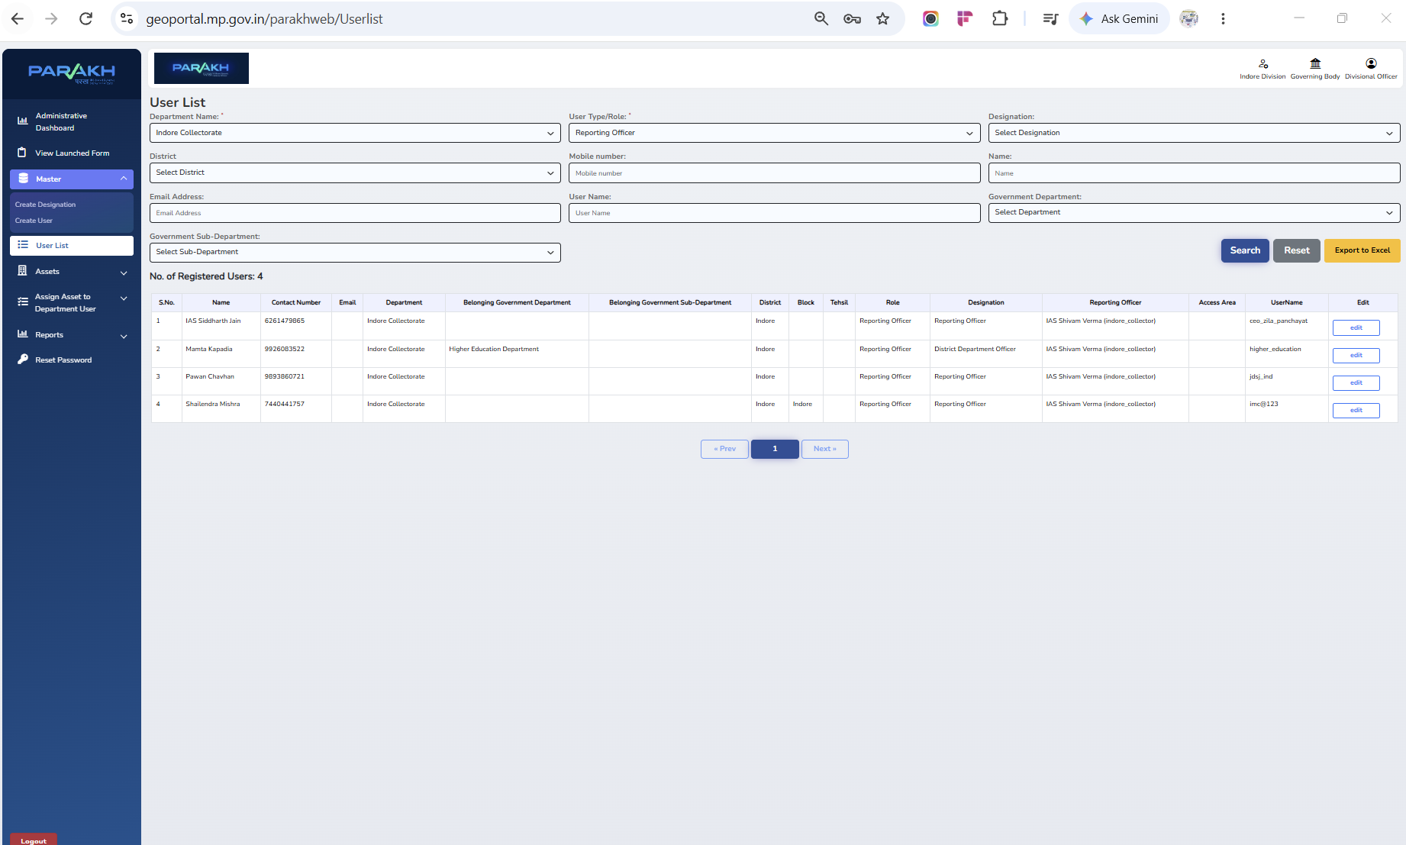
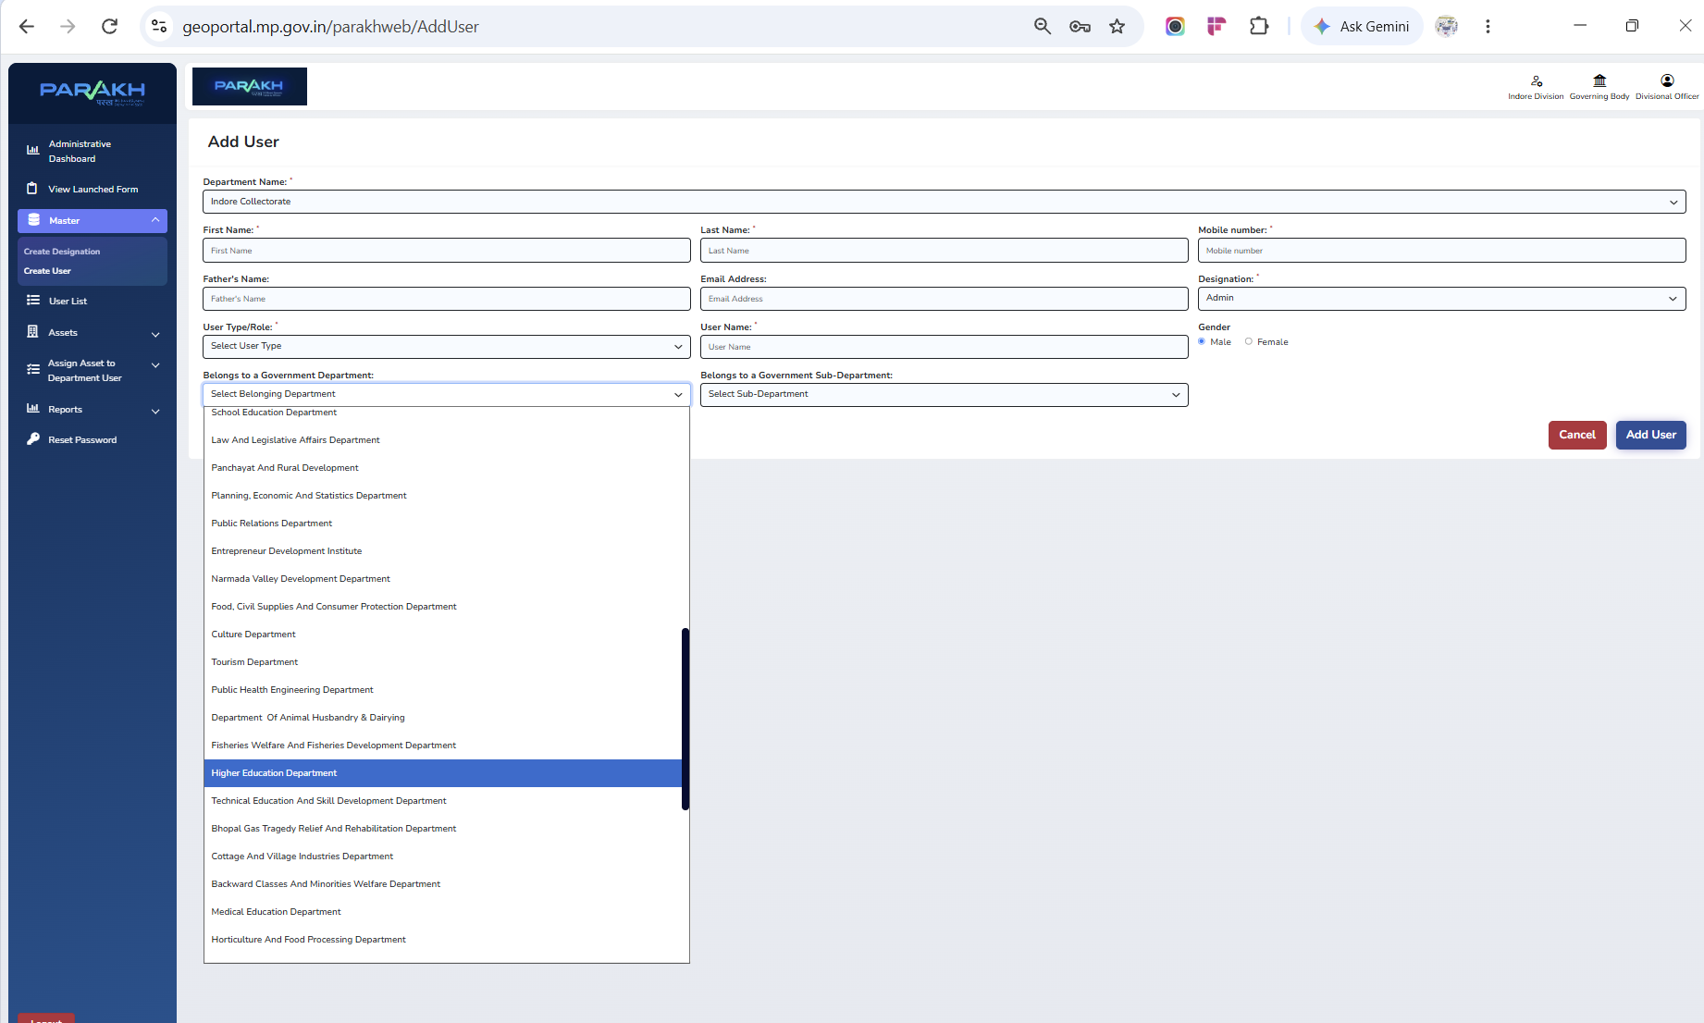
Access & Action Governance Model
Who can see an inspection vs. who can act on it — hierarchy-scoped Verify/Reject
Visibility vs. Action rights
• Inspector / Field Officer / Surveyor records are visible (read-only) to all departments within that district — giving full cross-department transparency on ground-level inspection activity.
• Verify / Reject action, however, can only be taken by the specific Reporting Officer (RO) under whom that Field Inspector/Surveyor was created — not by any other RO in the district.
• That RO's own actions roll up through the reporting hierarchy to the Nodal Officer above them, keeping one clear line of accountability from Inspector → RO → Nodal Officer.
• This is enforced by the Reporting Officer column captured against every user at creation time (see the User List extract alongside), not by a hard-coded, one-off rule.
User List — each Inspector/RO mapped to a Reporting Officer
NEW — Left Menu Panel
• ‘Action – Verify & Reject’ added as its own menu item, separate from Reporting.
• ‘Action Reports’ will be visible inside the Reports section.
Add User — Government Department / Sub-Department captured at creation
Confirms: 'authority to act rests only with the concerned department's HOD, in the RO role' — Indore Division Forms MoM
5

Slide 6
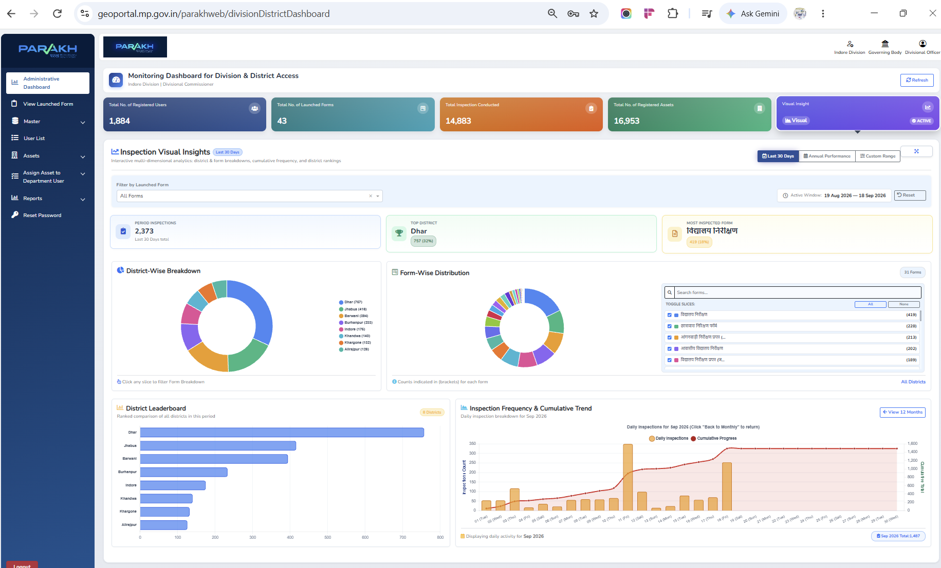
Divisional Monitoring Dashboard — Live
Monitoring Dashboard for Division & District Access — Indore Division
1,884
Registered Users
43
Launched Forms
14,883
Inspections Conducted
16,953
Registered Assets
Last 30 Days Snapshot
• 2,373 period inspections
• Top district: Dhar (757 — 32%)
• Most-inspected form: विद्यालय निरीक्षण (419 — 18%)
• 31 forms tracked; district & form-wise breakdowns, leaderboard and cumulative trend charts
Administrative Dashboard — geoportal.mp.gov.in/parakhweb/divisionDistrictDashboard
Active window: 19 Aug 2026 – 18 Sep 2026 • First dashboard version launched for Commissioner review per the 17-Sep MoM
6

Slide 7
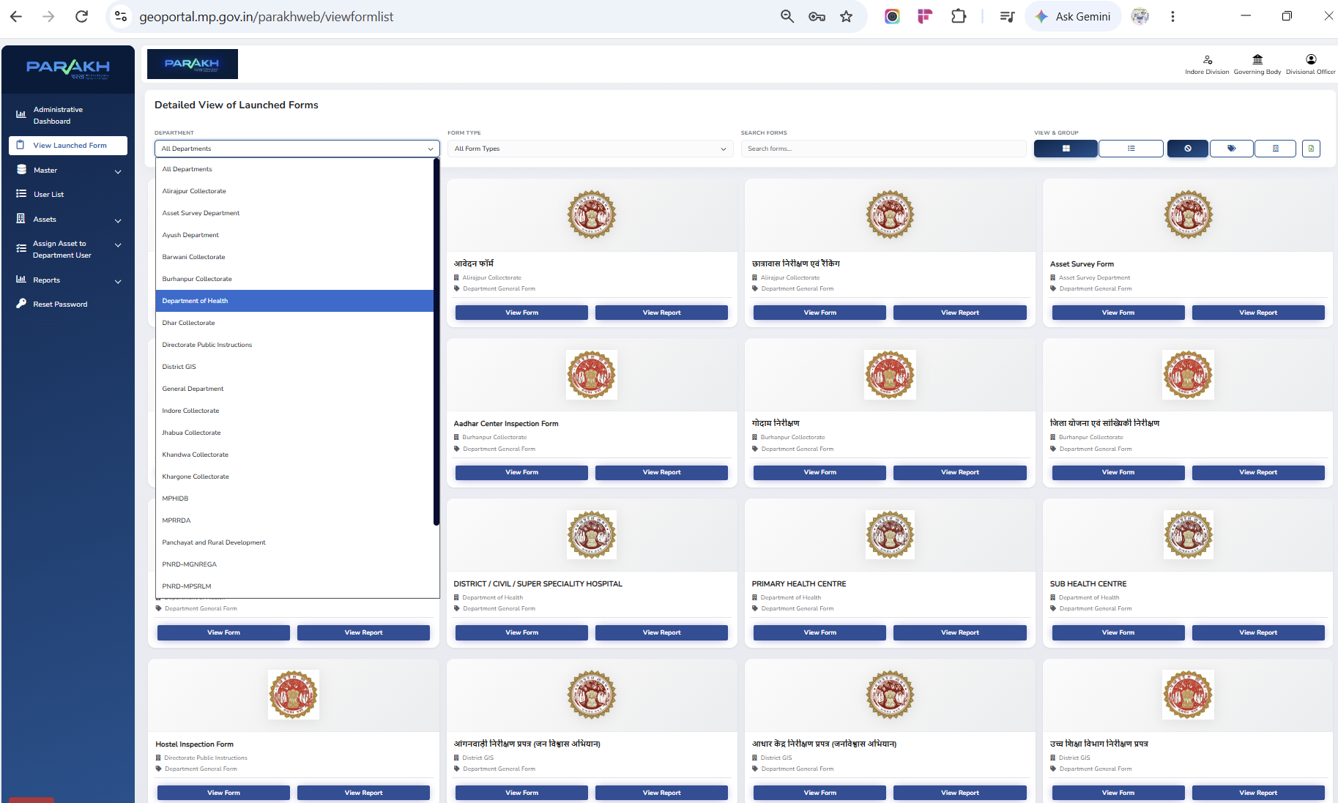
View Launched Forms — Bilingual Search (Hindi & English)
Detailed View of Launched Forms, filterable by Department and Form Type
What's new
• Search box finds a form by keyword in either Hindi or English — form names are shown in both languages, e.g. आवेदन फॉर्म, छात्रावास निरीक्षण एवं रैंकिंग.
• Department dropdown lists all 8 Indore Division collectorates plus cross-cutting departments (Ayush, Asset Survey, District GIS, PNRD-MGNREGA, PNRD-MPSRLM …).
• Every card is tagged ‘Department General Form’ and offers both View Form and View Report actions.
A generic, access-level-driven search utility was agreed on in place of a custom per-officer interface, so the form list stays manageable as more districts and departments are added.
View Launched Form — geoportal.mp.gov.in/parakhweb/viewformlist
Per the Indore Division Forms MoM: 'form names in both English and Hindi (in brackets) so staff at every level can search by keyword'
7

Slide 8
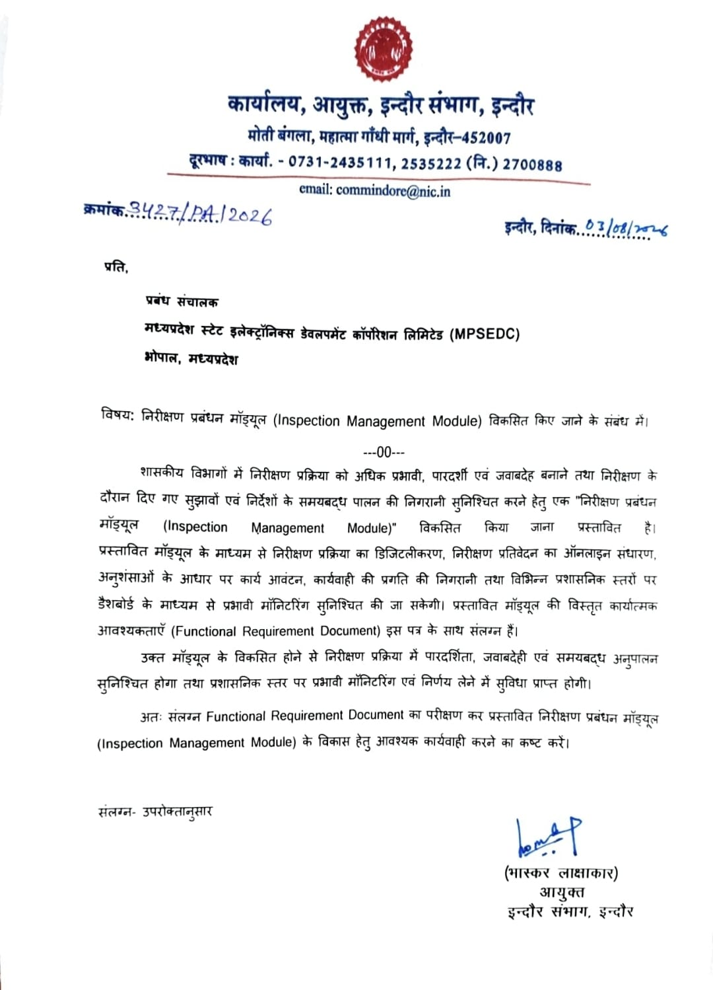
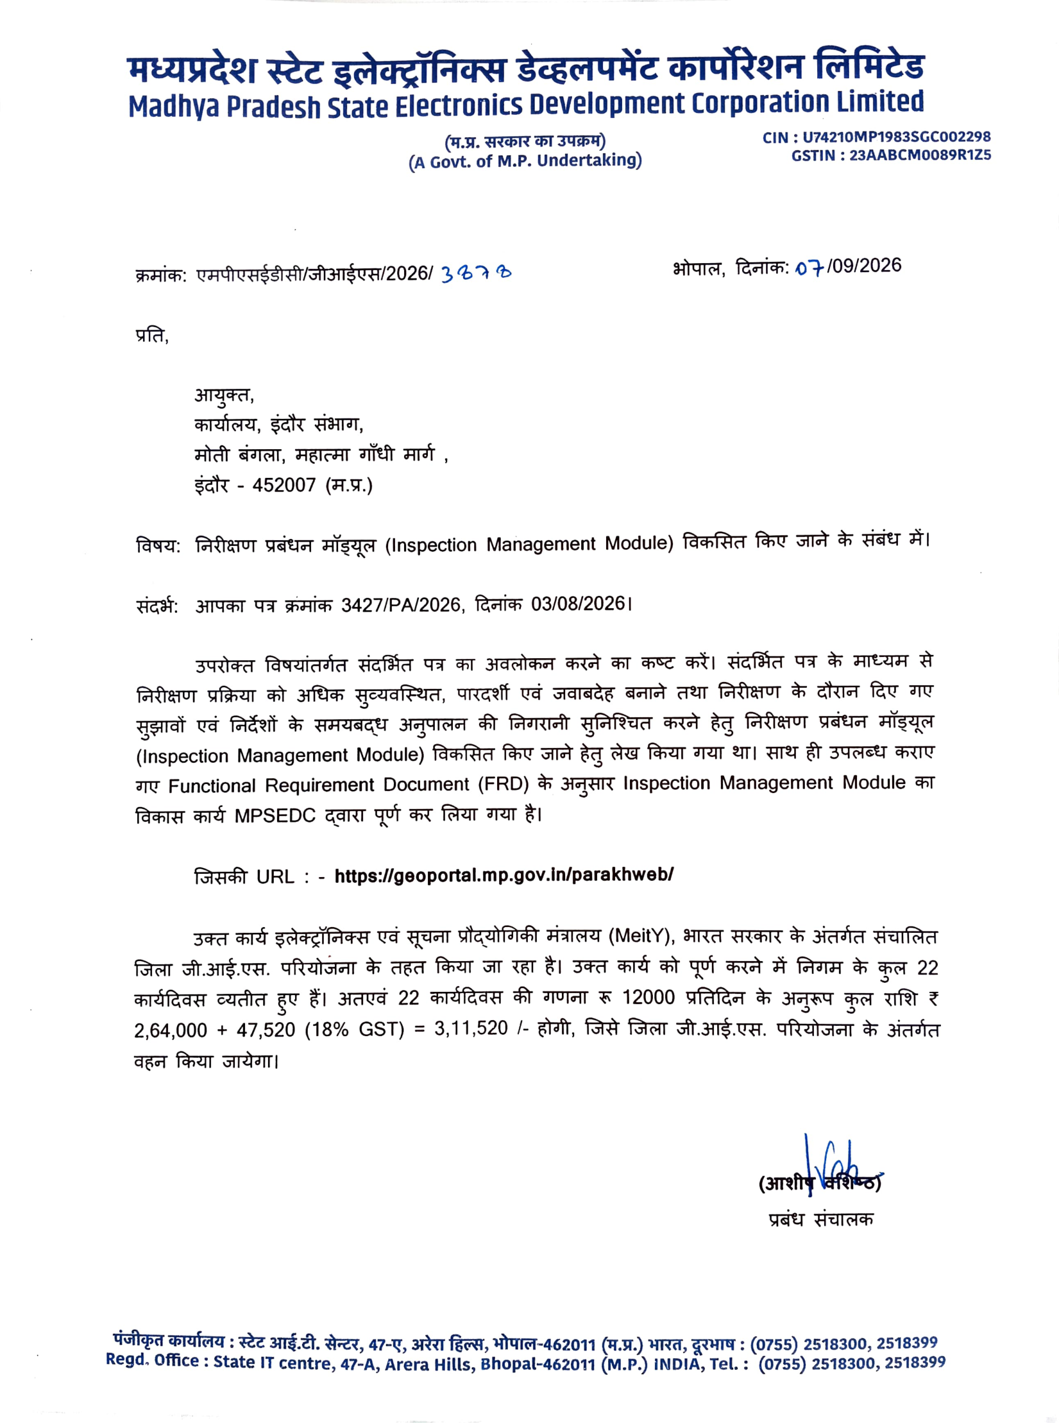
Official Letters | Inspection Management Module
Official communication supporting the Inspection Management Module
LETTER FROM COMMISSIONER, INDORE DIVISION
LETTER FROM MPSeDC
Official documents provided with the District GIS Parakh project materials

